Slide 1
Amendments to CHIPS Rules: Changing YOUR Practice
Hon. Janet Barke Cain
Carver County District Court
Member, Juvenile Protection, Adoption, and GAL Rules Committee
Hon. John McBride Washington County District Court
Chair, Juvenile Protection, Adoption, and GAL Rules Committee
To provide justice through a system that assures equal access for the fair and timely resolution of cases and controversies.
MJB Mission Statement
Notes:
On behalf of the Minnesota Judicial Branch, welcome to this training on the 2015 amendments to the Rules of Juvenile Protection Procedure.
Introduce yourself
Committee chair / committee member
County chambered
Presiding over CHIPS proceedings for ____ years
During today’s training session, all phone lines will be automatically muted. Throughout the session you may use the webex “chat” feature to submit your questions, which we will answer at the end of each section of the training. Also, at the end of the session we will open up the phone lines for additional questions.
It is possible that we may not be able to respond today to all questions. State Court Administration staff will keep track of all questions and will prepare and post an FAQ by the end of June.

Slide 2
Overview of Presentation
Why the rules were changed
Transition to electronic access
Responsibility of filers to segregate confidential documents and confidential information
Electronic filing and service
Notarization and signatures under penalty of perjury
Notes:
During today’s session we will cover the following topics:
The reasons why the Juvenile Protection Rules were changed
The transition to electronic access to Juvenile Protection case records
The responsibility of filers to segregate confidential documents and confidential information, including specific examples of how this will affect documents submitted by judges, county attorneys, social workers, guardians ad litem, and attorneys for parents and children
The expansion of electronic filing and service to include juvenile protection cases
The elimination of the notarization requirement in most instances

Slide 3
Why the CHIPS Rules Were Changed
To authorize electronic access to juvenile protection court records
To expand use of electronic filing and service to juvenile protection cases
To adjust the requirement for notarization of documents and allow signatures under penalty of perjury pursuant to Minn. Stat. § 358.116
Notes:
Background – Move from Paper to Electronic Information
In 2010, the Minnesota Judicial Branch embarked on an historic step into the future with the decision to move state courts from a framework of paper files to an electronic information environment.
Starting in 2010, eleven counties began as pilot sites for the eCourtMN transition.
In those counties, attorneys and government agencies were required to electronically file and serve documents in certain civil and family case types; e-filing and e-service was voluntary in all other case types.
In June 2014, the eCourtMN Steering Committee approved moving forward with mandatory e-filing and e-service for all case types within the pilot counties by July 2015, and in all other counties by July 2016.
In order to implement mandatory e-filing and e-service, amendments to Minnesota’s court rules were necessary.
The Supreme Court charged each of the rules committees with the task of recommending proposed amendments that would accommodate the transition to an electronic environment
Overview of why changes were made
The amendments to the Rules of Juvenile Protection Procedure were implemented for the following reasons:
To authorize electronic access to juvenile protection court records
To expand the use of electronic filing and service to juvenile protection cases
To repeal the requirement for notarization of documents in most instances and, instead, to require signatures under penalty of perjury
Committee Deliberations – Balancing Competing Interests
In making its recommendations to the Supreme Court, the rules committee attempted to balance several important competing interests, including the desire to allow public access to juvenile protection court records while at the same time ensuring privacy for abused and neglected children.
The majority of the discussions focused on the transition to electronic access to juvenile protection case records. (Adoption records will remain confidential.)
Electronic access will make it much easier for the public to review juvenile protection records, but could also increase the possibilities for invasions of children’s privacy.
For that reason, the committee recommended a change in how confidential information is processed.
The Minnesota Judicial Branch is expanding electronic filing and service through the Court’s eFS System. The Juvenile Protection and Adoption Rules needed to be revised to be consistent with this.
Minnesota state law now allows for non-notarized signatures in court documents to be subject to the penalty of perjury. See Minn. Stat. § 358.116. With a few exceptions, the court rules will not require that signatures be notarized.

Slide 4
Timing of Rules Changes
Segregate confidential documents and information
Effective 7/1/2015
For CHIPS cases in all counties
All CHIPS filers must segregate confidential documents and confidential information
Mandatory eFiling and eService (eFS)
7/1/15 for all case types in pilot counties
7/1/16 for all case types in all counties
Notes:
Before we begin our discussion of the changes to the rules, I want to be clear about the timing of when these changes will take place.
Changes to the Child Protection Rules will be effective on July 1, 2015. Later in the presentation, I will spend time talking about new requirements to segregate confidential documents and information in CHIPS filings. These requirements take effect on July 1 of this year in all counties. These requirements will be in place regardless if you’re in an e-filing county or if you are still filing by paper.
We will also spend some time talking about changes to the General Rules, and what the changes mean for eFiling and eService. Pilot counties will have mandatory eFiling and eService in all case types on July 1, 2015. In all other counties, mandatory eFS in all case types will begin July 1, 2016.

Slide 5
Transition to Electronic Access
Electronic access at courthouse terminals to public case records, register of actions, and calendars
Public CHIPS documents filed before 7/1/15 not available to public in electronic format
Public CHIPS documents filed on or after 7/1/15 are available to public in electronic format
Minn. Juv. Prot. P. R. 8.03, 8.06; Minn. Pub. Acc. R. 8, subd. 2(d)
Notes:
Redaction by court staff not sustainable
CHIPS records have been accessible to the public since 2002. Currently, records are accessible only in paper format, not in electronic format.
Under the current process, when a member of the public requests access to CHIPS records, court staff must create paper copies and redact all confidential information before allowing access.
This process is slow, labor-intensive, and is not sustainable in an electronic world where documents are accessible as soon as they are filed.
What is and is not publicly accessible
Effective July 1, we will transition to electronic access to records.
CHIPS records will continue to be segregated into those that are publicly accessible and those that are not publicly accessible.
For example, as is currently the case, petitions, orders, social worker reports, and GAL reports will continue to be public, but medical records and psych evals will not be public.
“Public records” will also include the register of actions, calendar, party indices, and judgment dockets.
Public access depends on date document filed
Public CHIPS records filed on or after July 1, 2015, will be available to the public in electronic format.
For cases initiated before July 1, 2015, that stay open after July 1, 2015, only the documents filed after July 1 will be available electronically.
If a member of the public seeks access to a document filed prior to July 1, court staff have discretion to redact the confidential information or to send it to the person who filed it and ask that person to submit a redacted version
Method of electronic access
Public CHIPS records will be viewable at courthouse access terminals. Any public CHIPS record can be viewed on any courthouse access terminal in the state. This will make it easier for people to view the records.
The Judicial Branch will be expanding public remote access to many types of case records at its public access website.
However, CHIPS records will not be accessible via the public website so as to promote the confidentiality of children’s information and lessen the possibility that such information will fall into the hands of predators and data miners.

Slide 6
Exceptions to Electronic Access
These records will not be electronically accessible:
Records in cases where a child is a party
Confidential information and documents listed in Rule 8.04
Minn. Juv. Prot. P. R. 8.01, 8.04, subds. 2 and 4(c); Minn. Pub. Acc. R. 4, subd. 1(o)(2)(D)
Notes:
As noted earlier, some records will not be electronically accessible to the public. These include:
Records in cases where a child is a party.
Cases in which children are parties will be confidential. The committee recommended this exception because it believed that members of the public should not be able to use children’s names to search for CHIPS cases. It is not technologically possible to restrict searches by party names for cases in which children are parties.
This means that if there are siblings involved in the case and one of the children is a party and the others are participants, then the case is not accessible to the public.
Confidential information and documents:
Juvenile Protection Rule 8.04 lists several types of documents that are inaccessible to the public.
Examples include medical records, psych evals, records about HIV, and the part of the case plan that includes the child’s education, physical health, and mental health records.
Juvenile Protection Rule 8.04 also lists several types of information that is inaccessible to the public.
Examples include the identity of a reporter of abuse, the identity or location of a foster parent, and the name of a child who is the victim of an alleged or adjudicated sexual assault.

Slide 7
Three Tiers of Access
There are three tiers of access to CHIPS records:
Access by the public
Access by parties
Access by participants
Minn. Juv. Prot. P. R. 8.04, subds. 2, 3, 4
Notes:
There are three tiers of access to CHIPS records:
Access by the public
Access by parties
Access by participants
In the next few slides we will discuss each of these in detail.

Slide 8
Access by the Public
The public will have immediate access to public CHIPS records at courthouse terminals, including social worker and GAL reports
The public will not have access to confidential documents and confidential information
Judges can order public access to confidential documents if exceptional circumstance exists
Minn. Juv. P. R. 8.04, subds. 3(a) & 4
Notes:
The public will have immediate access at courthouse terminals to inspect and copy all public juvenile protection case records in the court file, including social worker and guardian ad litem reports.
The public will not have access to confidential documents listed in Rule 8.04, subdivisions 2 and 4.
The public also will not have access to confidential information listed in Rule 8.04, subdivision 2.
Exception – Order Authorizing Access
A judge may issue an order permitting public access to confidential records. The judge must find that an exceptional circumstance exists. The order making the records confidential is accessible to the public.

Slide 9
Access by Parties
Parties have access to all public and most confidential records
Exceptions:
Recordings of children reporting abuse
Reporters of abuse or neglect
Information about HIV testing
Records subject to protective orders
Minn. Juv. Prot. P. R. 8.04, subd. 3(b)
Notes:
Parties will have access to all of the public records in their cases, as well as to most of the confidential records.
There are three types of confidential records that are not accessible to parties:
recordings of children reporting or alleging abuse or neglect of any child
information that identifies the reporters of child abuse or neglect
information about HIV testing. The language of the rules has been clarified to provide that all records of HIV testing are confidential. This includes information that reveals that a person has undergone HIV testing as well as the results of testing.
A judge may order that a party’s access to specific information be restricted. A judge may grant a party access to inaccessible confidential information if an exceptional circumstance exists.
This rule preserves the existing level of access for parties.

Slide 10
Access by Participants
Participants have access to public court records
Participants may request access to confidential records orally or in writing – they are not required to file motions for access
If the judge grants access, participants will have the same access as parties
Minn. Juv. Prot. P. R. 8.04(c)
Notes:
Participants (such as fathers who have not been named as parties, foster parents, and children) have access to public court records.
Participants do not automatically have the same level of access to confidential information that parties have, but may request access.
A participant’s request may be on the record or in writing, but need not be in motion format
This is the first time the rules have expressly set out the level of access for participants.

Slide 11
Segregation of Confidential Information
Electronic access to CHIPS records will mean that the records are available at every courthouse in the state as soon as they are filed
Currently, court staff review CHIPS records for confidential information before providing access
Redaction is not practical with the switch to electronic filing
Notes:
Our next topic deals with the responsibility of filers to segregate confidential documents and confidential information.
The change to electronic access will mean that CHIPS records are available at every courthouse in Minnesota as soon as they are filed.
As noted earlier, it will not be possible for court staff to review filings for confidential information and redact before they are accessible to the public.

Slide 12
Filers Must Segregate Information
Filers already responsible for segregating restricted identifiers and financial source documents under General Rule of Practice 11
Starting 7/1/15 a similar process will apply to CHIPS cases
Filers will be responsible for segregating confidential information and confidential documents
Notes:
In other types of cases, filers are responsible for ensuring that restricted identifiers (such as Social Security Numbers) do not appear in public court documents.
They are required to segregate restricted identifiers and put them on a separate, confidential form.
Starting July 1, there will be a similar requirement for CHIPS cases requiring segregation of confidential information and confidential documents.

Slide 13
Confidential Documents and Information
Notes:
Here is the handout containing the list of confidential documents and confidential information.
“Confidential information” includes:
Portions of records that identify reporters of abuse or neglect
Records of HIV testing or records that reveal a person has been tested for HIV
Portions or records that identify a minor victim of alleged or adjudicated sexual assault
Records which a court in exceptional circumstances has deemed inaccessible.
“Confidential documents” include:
Official transcripts of closed proceedings
Recordings of children alleging or describing abuse or neglet
Victims’ statements
Medical records, chemical dependency evaluations and records, psychological evaluations and records, and psychiatric evaluations and records
Sex offender treatment program reports
Portions of photographs that identify a child
Applications for ex parte emergency protective orders until there has been a hearing where a party had the opportunity to be heard
Notices of proceedings provided to Indian tribes under ICWA
Records identifying foster or shelter care placements
Education, physical health and mental health records contained in or attached to a case plan.

Slide 14
Filers Must Segregate Information
Confidential documents under “Confidential Documents Cover Sheet Form 11.3”
Confidential information on “Confidential Information Form 11.4”
This is a major change for filers, including county attorneys, GALs, and social workers
Minn. Juv. Prot. P. R. 8.04, subd. 5
Notes:
Filers and court staff will no longer “redact” information from documents and will no longer file both a “clean” version and a “redacted” version of documents.
Instead, the process is better understood as “segregating” confidential information and placing it on a separate form.
Filers must ensure that confidential information never appears in public documents.
Confidential documents will be submitted under a Form 11.3 cover sheet
Confidential information forms will be submitted on a Form 11.4 form.
The next few slides show examples of how confidential documents and confidential information will be segregated.

Slide 15
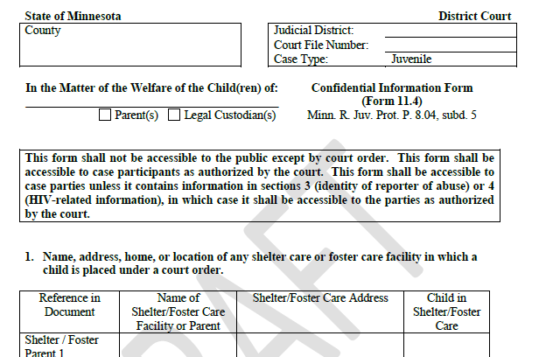
Confidential Information – Form 11.4
Notes:
First, we will talk about filing confidential information.
This is a draft of one of the new forms – Confidential Information Form 11.4.
The form draft is located in the materials distributed for this training.
Once finalized, it will be available on the forms page of the Judicial Branch public website.
The form will be used by filers to provide all information that is inaccessible to the public.

Slide 16
Example: Segregation of Child and Foster Parent Name
Notes:
Let’s start with confidential information and Form 11.4.
This slide shows a sample CHIPS petition filed PRIOR TO July 1, 2015.
As you can see, there are two children involved in this case – Robert Anderson and Sally Anderson.
The petition lists each child’s name, date of birth, gender, and address in foster care
The petition also lists the name and address of the foster parents – the Smith Foster Home and the Jones Foster Home
The juvenile protection rules require all of this information to be included in the CHIPS petition

Slide 17
Example: Segregation of Child and Foster Parent Name
Notes:
This slide shows a sample CHIPS petition filed AFTER July 1, 2015.
The same two children are involved in this case – Robert Anderson and Sally Anderson.
Both of the children are in foster care, with different foster parents. But the names and addresses of foster parents are not accessible to the public, so that information is not included in the petition. Instead, the foster parent names and addresses are listed on Confidential Information Form 11.4, which we will show in a minute.
In addition, one of the children is an alleged victim of sexual assault, which means the child’s identity is not accessible to public and, therefore, is not included in the petition. Instead, the child’s identity is listed on Confidential Information Form 11.4
You will see that the petition references “Child 1.” That is the correct way to reference children: Child 1, Child 2, etc. Children should not be referenced by their initials.
Other parties and participants should use the same child references in the documents they file. For example, if the petition refers to Robert as “Child 1” and Sally as “Child 2”, then all other filers should use the same references in their documents.
While this is an example of a petition filed by a county attorney, the same process will be used by social workers, guardians ad litem, and attorneys for parents and children in the documents they file.

Slide 18
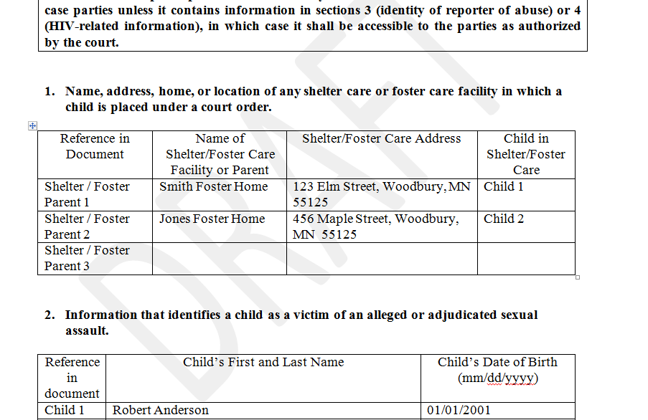
Sample Confidential Information – Form 11.4
Notes:
This slide shows a sample of how a Confidential Information Form 11.4 will be completed by the filer.
Included in section 1 are the names and addresses of the foster parents (the Smiths and the Jones)
Included in section 2 is the name of the child (Robert Anderson) who is an alleged victim of sexual assault
Form 11.4 remains confidential, and the petition filed without the confidential information is immediately available to the public at electronic terminals at the courthouse.

Slide 19
Failure to Comply
If court staff see confidential information in a public document:
Court staff place the document on confidential status
Court staff will direct the filer to submit a properly prepared version along with form 11.4
Minn. Juv. Prot. P. R. 8.04, subd. 5
Notes:
If court staff see confidential information in a public document, they are required to place the document on confidential status and direct the filer to promptly submit a properly segregated version of the document along with a confidential information form 11.4.

Slide 20
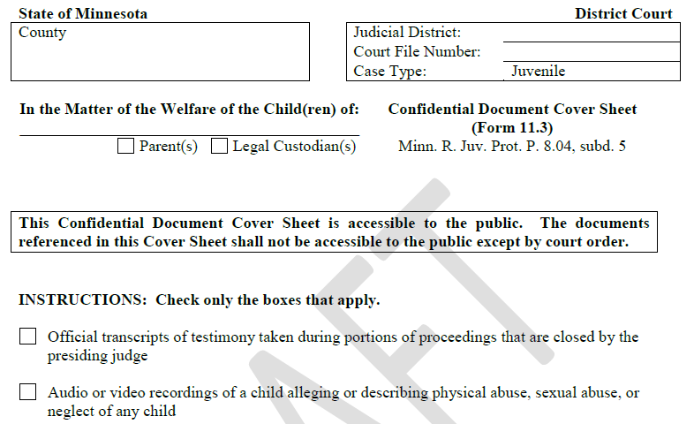
Confidential Documents – Form 11.3
Notes:
Next, we will talk about filing confidential documents.
This is a draft of one of the new forms – Confidential Document Cover Sheet Form 11.3.
The form draft is located in the materials distributed for this training.
Once finalized, it will be available on the forms page of the Judicial Branch public website.
The form lists all documents that are confidential and inaccessible to the public.
If a filer intends to file one of the confidential documents as part of a case, the filer must use this cover sheet to submit the document.
The filer will place a check mark in the box next to each type of confidential document being filed.
Multiple confidential documents can be submitted with each cover sheet.
The filer will file the cover sheet separately and it will have its own event code.
The filer will file each confidential document separately and each document will have its own event code.
Once the cover sheet and related documents are submitted, court administration staff will “relate” the documents in MNCIS so the court and public know which documents were submitted along with that specific cover sheet

Slide 21
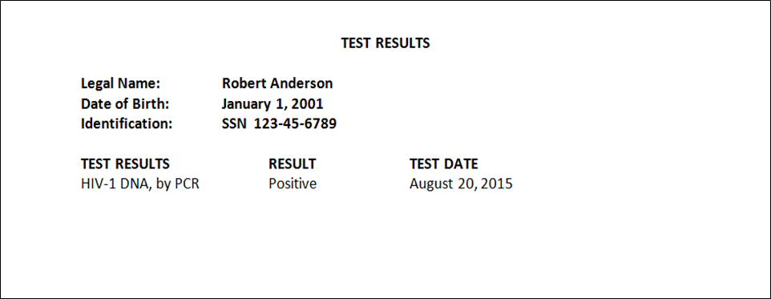
Sample Confidential Document – Form 11.3
Notes:
This is an example of a confidential document under Juvenile Protection Procedure Rule 8.04. (A document that is an HIV test result qualifies as a “confidential document.” Any reference to a person’s HIV status in a public document qualifies as “confidential information.”)

Slide 22
Example Form 11.3
Notes:
Here is a portion of the Form 11.3 cover sheet that the filer will submit for the confidential document.
Form 11.3 is public. Nothing is redacted from the submitted document, however, because that document (such as HIV report) remains confidential.

Slide 23
Failure to Comply
If court staff see confidential documents that have not been designated as confidential:
Court staff place the document on confidential status
Court staff will direct the filer to submit a confidential document cover sheet
Minn. Juv. Prot. P. R. 8.04, subd. 5
Notes:
The rules direct court staff on how to respond to filers who do not comply with the rules for filing confidential documents and confidential information.
If court staff see confidential documents that have not been designated as confidential:
Court staff will place the document on confidential status, and
Court staff will the filer to submit a confidential document cover sheet.

Slide 24
Filers’ Duty to Comply
Court staff are NOT responsible for screening for confidential information and confidential documents
Filers must segregate information with Forms 11.3 and 11.4
Judges can sanction filers for non-compliance
Minn. Juv. Prot. P. R. 8.04, subd. 5.
Notes:
Court staff are not responsible for screening filings for compliance with the confidential information rules.
If court staff see confidential information that has not been properly filed, they must rectify the mistake by making the document confidential and contacting the filer.
Judges have authority to sanction filers for failure to properly submit confidential records. This provision was not recommended by the committee, but was added by the Supreme Court.
Judges should keep in mind that, with the expansion of access to CHIPS cases, failure to properly file confidential records can cause great harm to the people involved in CHIPS matters.
General Rule of Practice 11.04 now directs court staff to strike filings for failure to segregate Social Security Numbers. Unlike General Rule of Practice 11, the CHIPS rules do not authorize striking of pleadings for failure to redact confidential information.

Slide 25
Social Workers and Guardians ad Litem
Social worker and guardian ad litem reports shall not contain confidential information
Social workers and guardians ad litem are responsible for complying with the court rules
Social workers and guardians ad litem must use Forms 11.3 and 11.4
Notes:
Many public comments asked the Minnesota Supreme Court to ensure that social worker and guardian ad litem reports be readily accessible to the public. The Court agreed with those commenters’ views.
The segregation requirements that we just discussed apply to all filers, including social workers and guardians ad litem.
This means that social workers and guardians ad litem will need to segregate confidential information in the reports and case plans they file.
Social workers and guardians ad litem who fail to segregate confidential information may be sanctioned by the court.
Social workers and guardians ad litem should be careful to use consistent pseudonyms throughout the case.
These forms will be made available to the Department of Human Services when they have been finalized by the Judicial Branch.

Slide 26
Social Worker Report – Current Practice
Notes:
This is an excerpt from a mock social worker report (filed prior to July 1, 2015) about Robert and Sally Anderson. You can see that it contains the identity of a child alleged to be a sexual abuse victim and the identity of the reporter of abuse.

Slide 27
Social Worker Report – New Practice
Notes:
Here is the same report with the confidential information segregated. You can see that Robert is referred to as “Child 1”, and that the reporter of abuse is not identified.

Slide 28
Social Worker – Form 11.4
Notes:
Here is a portion of the Confidential Information Form 11.4 that the Social Worker would use for the confidential information.
Dr. David Smith is identified as the reporter of abuse, and information about HIV testing is provided.

Slide 29
Implications for Court Staff and Judges
Court staff cannot include confidential information in records they create – hearing notices, registers of actions, calendars
Judges have discretion to include confidential information in orders they create, but should do so cautiously
Orders need to incorporate confidential attachments containing children’s names
Minn. Juv. Prot. P. R. 8.05
Notes:
The rules prohibit court staff from including confidential information in records they create (notices of hearings, registers of action, etc.).
Judges have discretion to include confidential information in orders and other records they create, but should consider the effects that public access to that information may have because the order and the information will remain public. The committee recommends that judges be very cautious about including such information in their orders.
Judges may decide to exclude the names of children from orders; for example, when the child is a victim of sexual abuse. Judges should be sure to include the names in confidential attachments that are incorporated into the orders. If this is not done, then the state of Minnesota may not be reimbursed by the federal government for out-of-home placements for the children.

Slide 30
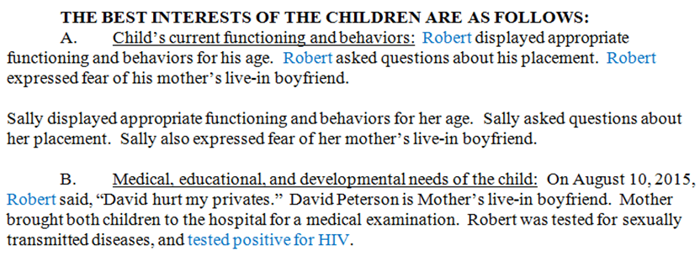
Example of a Publicly Accessible Order
Notes:
Judges should be cautious about including the names of children in public CHIPS orders. This is an excerpt of an order from the fake CHIPS file that we saw earlier, involving Robert and Sally Anderson.
Assuming this order is filed after July 1, 2015, it will immediately be accessible to the public at every courthouse access terminal in Minnesota.
Anyone will be able to look at the order and learn that Robert Anderson was an alleged victim of sexual assault, and that he has been infected with HIV.

Slide 31
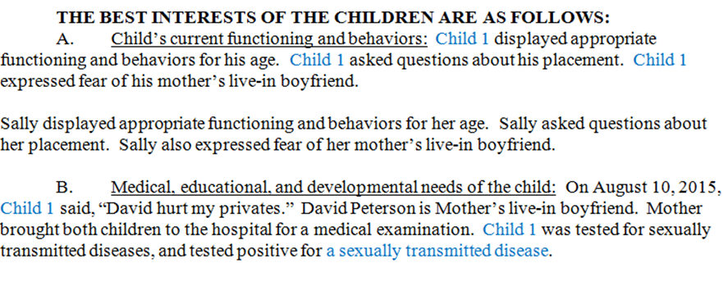
Order with Segregated Information
Notes:
This is an example of how a judge could draft the same order.
Robert is referred to as “Child 1,” consistent with the pseudonym used in previous filings to the court. His HIV diagnosis is not in the public order.
Drafting an order in this manner would also be a consideration for a party that is submitting a proposed order.
When drafting petitions, reports, or orders we should consider that if there is a “Child 1” and a Sally, then that means Child 1 is a victim of sex abuse. An alternative would be to use Child 1, Child 2, Child 3 for all the children in every document so that public documents do not reveal confidential information.

Slide 32
Attachment with Child’s Name
Notes:
This is an example of how you might include the child’s name in a confidential attachment to the order.
The order should expressly incorporate the attachment. This will help ensure that the placement of the child is eligible for federal reimbursement funds.
Understanding and implementing the new rules for segregation of confidential information for public documents will be a distinct change in the practice of law for CHIPS cases. All judges, attorneys, social workers, and other people involved in CHIPS cases will need to pay particular attention to the new rules on access to court records.

Slide 33
Electronic Filing of Documents
General Rule of Practice 14, which applies to CHIPS and adoption cases, requires electronic filing of documents for “Select Users”
This starts 7/1/15 in the eCourtMN pilot counties, and 7/1/16 in the remaining 76 counties
Excused only by order of Chief Judge upon good cause shown
Minn. Gen. R. Prac. 14.01(b); Minn. Juv. Prot. P. R. 31.01, subd. 1; Minn. Adop. P. R. 25.01, subd. 1.
Notes:
The next topic is electronic filing and service.
General Rule of Practice 14 is the rule that governs electronic filing and service, including in CHIPS and adoption proceedings.
Rule 14 requires electronic filing of documents for “select users” through the “eFS” (electronic filing and service) system.
The requirement begins July 1, 2015, for pilot counties, which are Cass, Clay, Cook, Dakota, Faribault, Hennepin, Kandiyohi, Lake, Morrison, Ramsey, and Washington Counties.
The requirement begins July 1, 2016, for all remaining counties.
Filers may be excused from use of electronic filing only by order of the Chief Judge upon a showing a good cause.

Slide 34
Who is a “Select User”?
“Select Users” are:
Attorneys
Guardians ad litem
Government agencies
Social workers are Select Users because they are employees of government agencies
Minn. Gen. R. Prac. 14.01(a)(10).
Notes:
“Select Users” are those who are required to use the eFS System for filing in Juvenile Protection and Adoption cases.
They include attorneys, guardians ad litem, and government agencies.
Social workers are Select Users because they are employees of government agencies.

Slide 35
Voluntary Electronic Filing
Once electronic filing is available to Select Users, all other filers (including self-represented litigants) have the option of filing electronically
Anyone who chooses to file electronically must continue to file electronically for the rest of the case, unless excused by order of the presiding judge
Minn. Gen. R. Prac. 14.01(b).
Notes:
Filers who aren’t Select Users may file electronically whenever Select Users are required to file electronically. This includes all self-represented litigants.
Any person who chooses to file electronically must continue to file electronically for the rest of the case, unless excused by order of the presiding judge.

Slide 36
Exceptions to Electronic Filing: ICWA
Attorneys representing Indian tribes are not required to use the electronic filing system, but may do so voluntarily
This exception is made to ensure the tribes can fully exercise their rights under the Indian Child Welfare Act.
Minn. Juv. Prot. P. R. 3.06; Minn. Adop. P. R. 3.09
Notes:
Attorneys representing Indian tribes are not required to file documents using the electronic filing system, but may do so voluntarily
This exception is based upon precedents from other jurisdictions holding that Indian tribes appearing in juvenile protection matters are not required to be represented by attorneys

Slide 37
Exceptions to Electronic Filing: In camera
Documents submitted for in camera review are submitted in the manner directed by the presiding judge
Court staff retain the documents as part of the record, unless the judge directs otherwise
Minn. Gen. R. Prac. 14.01(b); 14.03(h); 14.06.
Notes:
Documents submitted for in camera review are submitted in the manner directed by the presiding judge.
Court staff retain the documents as part of the record, unless the judge directs otherwise.

Slide 38
Electronic Service
All electronic filers must use the eFS System to serve other electronic filers
The record of service in the eFS System is sufficient proof of service and no affidavit of service is required
Discovery can be served using the eFS system, but should not be filed
Minn. Gen. R. Prac. 14.03(d); Minn. Juv. Prot. P. R. 31.02, subd. 4; Minn. Adop. P. R. 25.02, subd. 4.
Notes:
All electronic filers must use the eFS System to serve other electronic filers.
The record of service in the eFS system is sufficient proof of service, and no affidavit of service is required for service through the eFS System.

Slide 39
Non-Electronic Service
All service that is not between electronic filers must be done outside the eFS System.
This includes service by electronic filers on non-electronic filers, and all service by non-electronic filers.
Affidavits of service are required for service outside the eFS System.
Notes:
Service that is not between electronic filers must be done outside the eFS System.
This includes service by electronic filers on non-electronic filers, and all service by non-electronic filers.
Affidavits of service are required for service outside the eFS System.

Slide 40
Service by Court Staff
Court staff have discretion to serve documents by the most appropriate means, including:
Through eFS System
Personal service at the hearing
Service by e-mail
Service by mail
Alternative personal service
Service by publication
Minn. Gen. P. R. 14.02(f); Minn. Juv. P. R. 10.03, subd. 1
Notes:
Unless personal service is required by rule, court staff have discretion to use the most appropriate means of service for documents such as orders and notices.
It is very cumbersome for court staff to transfer documents from MNCIS to the eFS System.
Often, it may be easiest for court staff to serve documents by e-mail or by personal service at the hearing.
The summons and petition will continue to be served personally, unless publication or alternative personal service is authorized.

Slide 41
Notarization and Perjury
The Supreme Court has nearly eliminated the requirement of notarization
Under General Rule of Practice 15, filers may choose to sign documents under penalty of perjury or under notarization
Two exceptions: admissions and settlement agreements
Minn. Gen. R. Prac. 15; Minn. Stat. § 358.116. Minn. Juv. Prot. P. R. 35.03, subds. 1, 2; Minn. Adop. P. R. 19.03.
Notes:
Our last topic is notarization and signatures under the penalty of perjury.
In an effort to transition to an electronic environment, Minn. Stat. § 358.116 authorizes non-notarized signatures under penalty of perjury, except when notarization is required by a court rule.
Documents signed under penalty of perjury must have this language above the signature: “I declare under penalty of perjury that everything in this document is true and correct.”
People who sign such documents while knowing they are false in any material respect are guilty of the felony of perjury.
Notarization is always acceptable.
Notarization is required for admissions in CHIPS cases and for settlement agreements in adoption cases. The committee recommended this distinction to help verify the identity of the people signing these documents, because they can lead to terminations of parental rights.

Slide 42
Time to Appeal
Supreme Court clarified time to petition for further review from Court of Appeals:
Petition for further review filed and served within 15 days
Response filed and served with 10 days
Minn. Juv. Prot. P. R. 47.01, 47.07
Notes:
The Supreme Court made a change that was not considered by the committee.
The change clarifies the deadlines for filing petitions for further review of Court of Appeals decisions in juvenile protection matters.
All petitions for further review must be filed and served within 15 days of the entry of the Court of Appeals decision.
All responses to petitions for further review must be filed and served within 10 days of service of the petition for further review.

Slide 43
Additional Resources
Public Website: www.mncourts.gov
Court Rules: www.mncourts.gov/rules
E-Filing: www.mncourts.gov/efile
Children’s Justice Initiative:
http://www.mncourts.gov/?page=148
Contact Ann Ahlstrom or Judy Nord at:
Ann.Ahlstrom@courts.state.mn.us
Judy.Nord@courts.state.mn.us
Notes:
Additional information is available on the Minnesota Judicial Branch’s public website. Links are available through the main page or can be accessed directly using the listed links
You may also contact Ann Ahlstrom and Judy Nord with questions.
We have included the link the Judicial Branch’s website so you can look at the new court rules. At this link, you can also find the list of additional CLEs being offered on the other new court rules. Additionally, if you are not in an efile and serve county, you will be shortly, since it is planned that efiling will be available statewide by the end of 2015. We have the link to the Efile webpage so that you can find out more information and also sign up for Efile and serve training. The material from today’s presentation and this talk will be posted on the CJI website before the end of June.

Slide 44
Questions?
Notes:
Questions?

